Slide 1
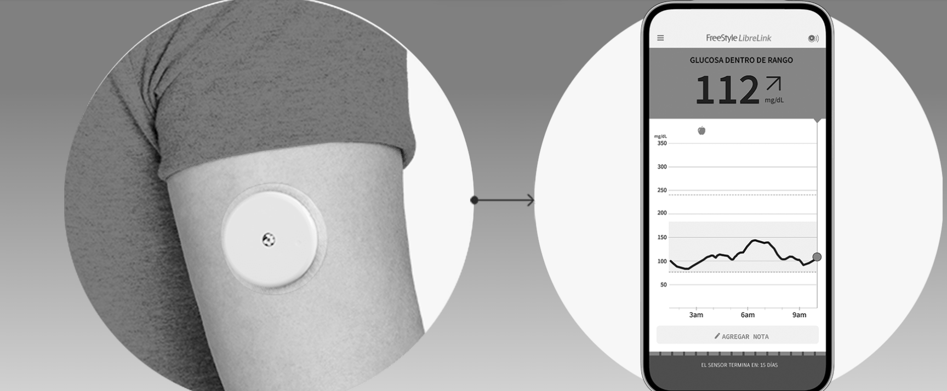


Slide 2
Instructions for a different size in PBI:
Look the canvas settings in PBI and divide in 100 the number of W and H.
Insert them in PP … Design… Slide Size… and apply them… select fit and put everything in the top
Crop the image(s) until all the PP is covered
Copy paste the image and extend the white box so it can fit almost in the bottom of the page (as the original one), the image must be until the very end, crop the parts are after the end of the slide.
Bring to the front of all the White square
For the images you added in case you change the image you need add manually the formating: right click, format, select the last button: Brightness 74%, Contrast 14% and Saturtaion 0%.
Save it in the folder of the report as a copy of the original one
Save it as image
Add it as background in PBI
PS: this template shouldn’t be changed, copy and paste for new projects with different sizes

